Slide 1
BRIEFING SESSION PRESENTATION
PRESENTED BY:
Zanele Mkhwanazi
Division: OCPO
Date: 12 March 2025 @10h00
RT66-2025:SUPPLY AND DELIVERY OF TACTICAL AND CRIME SCENE EQUIPMENT TO THE STATE FOR THE PERIOD OF THIRTY-SIX (36) MONTHS

Slide 2
RT66-2025: SUPPLY AND DELIVERY OF TACTICAL AND CRIME SCENE EQUIPMENT TO THE STATE FOR THE PERIOD OF THIRTY-SIX (36) MONTHS
AGENDA
1. Opening, welcome and Introductions
2. Purpose of the RFP
3. Duration of the Contract
4. Bid Timelines
5. How to access the Tender Document
6. Technical Specification and Scope of Work
7. Evaluation Criteria as per SCC
8 Terms and Conditions
9. Sample Evaluation
10. Question and Answers
11. Closure

Slide 3
RT66-2025: SUPPLY AND DELIVERY OF TACTICAL AND CRIME SCENE EQUIPMENT TO THE STATE FOR THE PERIOD OF THIRTY-SIX (36) MONTHS
Opening, welcome, and Introductions
Purpose of the RFP
The purpose of this request for proposal (RFP) is to solicit bids from interested parties (“Respondents”) to enable National Treasury to appoint suppliers for RT66-2025: SUPPLY AND DELIVERY OF TACTICAL AND CRIME SCENE EQUIPMENT TO THE STATE FOR THE PERIOD OF THIRTY-SIX (36) MONTHS
The RFP consists of the Special Conditions of Contract ( SCC), Technical Specification, GCC, Pricing Schedule, and other Standard Bidding Documents ( SBD).
To obtain market-related Prices and to ensure that the Government benefits from the economics of scale.
3. Duration of Contract – thirty-six (36) Months

Slide 4
RT66-2025 SUPPLY AND DELIVERY OF TACTICAL AND CRIME SCENE EQUIPMENT TO THE STATE FOR THE PERIOD OF THIRTY-SIX (36) MONTHS 4. Bid Timelines
ACTIVITY | DUE DATE
RFP Upload on e-Tenders Portal – Tender Document | The tender was advertised on e-Tender Portal & National Treasury website on 27 February 2025
Non-compulsory briefing session | 12 March 2025 at 10:00 – 11:00 ( Online session: MS Teams)
Bid Validity period | 180 Days from the closing date of the bid
Bid Closing date and Time | 31 March at 11:00am
Communication channels Deadline for Queries, Question and Answers | Attention: Contract Manager Email: Demand.Acquisition3@treasury.gov.za 20 March at 16:00

Slide 5
RT66-2025: SUPPLY AND DELIVERY OF TACTICAL AND CRIME SCENE EQUIPMENT TO THE STATE FOR THE PERIOD OF THIRTY-SIX (36) MONTHS
Where bid documents can be obtained:
National Treasury website
http://www.treasury.gov.za/divisions/ocpo/ostb/CurrentTenders.aspx
E-tenders: https://www.etenders.gov.za/

Slide 6
RT66-2025: SUPPLY AND DELIVERY OF TACTICAL AND CRIME SCENE EQUIPMENT TO THE STATE FOR THE PERIOD OF THIRTY-SIX (36) MONTHS
Technical Specification and Scope of Work
Bidders must be able to supply RT66-2025: SUPPLY AND DELIVERY OF TACTICAL AND CRIME SCENE EQUIPMENT TO THE STATE FOR THE PERIOD OF THIRTY-SIX (36) MONTHS as per the Technical Specifications. (paragraph 6.4.5 page 12 of the Special Conditions of Contract)

Slide 7
RT66-2025: SUPPLY AND DELIVERY OF TACTICAL AND CRIME SCENE EQUIPMENT TO THE STATE FOR THE PERIOD OF THIRTY-SIX (36) MONTHS
Evaluation Criteria as per clause 6 of the SCC
Phase 1 | Phase 2 | Phase 3 | Phase 4
Administrative requirements | Mandatory Requirements | Technical Requirements & Sample Evaluation | Price and Specific Goals
Compliance with administrative requirements | Compliance with mandatory requirement | Compliance with technical requirement | Bids evaluated in terms of the 90/10 preference system

Slide 8
RT66-2025: SUPPLY AND DELIVERY OF TACTICAL AND CRIME SCENE EQUIPMENT TO THE STATE FOR THE PERIOD OF THIRTY-SIX (36) MONTHS
PHASE 1: Administrative Requirements
Bidders are required to submit the required documents and must be completed in full.
SBD 1 – Invitation form to bid.
Proof of Authority – This is a company resolution for the capacity under which this bid is signed as per SBD 1.
SBD 4 – Bidders Disclosure
SBD 6.1 – Preference points claim form
TCD 13 and 13.1 Authorisation Declaration
Central Supplier Database
Written Confirmation to disclose tax status
CIPC company Registration

Slide 9
RT66-2025: SUPPLY AND DELIVERY OF TACTICAL AND CRIME SCENE EQUIPMENT TO THE STATE FOR THE PERIOD OF THIRTY-SIX (36) MONTHS
PHASE 2: Mandatory Requirements
Pricing Schedule

Slide 10
RT66-2025: SUPPLY AND DELIVERY OF TACTICAL AND CRIME SCENE EQUIPMENT TO THE STATE FOR THE PERIOD OF THIRTY-SIX (36) MONTHS
PHASE 3: Technical Compliance Evaluation
During this phase, the bidder's response will be evaluated based on the technical requirements for each item offered. Non-compliance with all the evaluation requirements below will result in the disqualification of the relevant line item being evaluated. The technical specification is in two parts, Part A and Part B. Only items which complied with Part A of the evaluation requirements will be evaluated further on Part B of the technical evaluation.
PART A:
1. TCD 13.2 Authorization Letter /Letter of Undertaking
Bidder who is sourcing goods or services from a third party is required to submit an authorisation letter in a third-party letterhead outlining all relevant goods or services.
Requirements for the authorisation letter to be valid
Must in a manufacturer or third part letterhead, dated and signed and must not be older than 30 days at the closing date and time of the bid
Must List items , description, brand name and model number
Contact details of the signatory i.e. address and telephone number
It must be written in English
2. Technical Specification
Bidders are required to indicate compliance with the technical specification document Annexure 4.
Bidders must not respond with “Yes” or “No” but must explicitly indicate whether they are compliant or not compliant.
Failure to complete the required information as specified above will invalidate the relevant line item.
3. Test Reports
All items offered will be verified against this requirement. The original test report must be in the name of the manufacturing company, bear a SANAS-approved stamp, and be on the testing company's letterhead. It must not be older than 24 months. Bidders must submit valid test reports from SANS or equivalent accredited institutions for all items requiring test reports. Bidders should carefully review the technical specification list in Annexure 4.
The procedures for sampling and testing for product compliance may differ and should be obtained from the relevant testing institution. The cost of compliance testing will be for the account of the bidder.
If the bidder submits an offer for an item that requires a test report and fails to submit the test report for the applicable item, it will result in the disqualification of the item offered.
.

Slide 11
RT66-2025: SUPPLY AND DELIVERY OF TACTICAL AND CRIME SCENE EQUIPMENT TO THE STATE FOR THE PERIOD OF THIRTY-SIX (36) MONTHS
PHASE 3: Technical Compliance Evaluation Continuation
4. Capability Report
Bidders must ensure that all items offered appear on the capability report to prove that the items offered are produced and manufactured locally. If a bidder is offering an item from a third party, locally or internationally imported items, the capability report of the third party must list all the item/s offered. If items do not appear on the capability report (s), the item affected will be disqualified.
The full capability report must be issued by an organisation accredited or recognised by SANAS. The capability report must explicitly indicate whether the bidder/manufacturer has the capability and capacity to manufacture the product(s)/items.
5. Certificate of compliance
Where applicable, bidders are required to submit a certificate of compliance verifying that a specific product, system, or installation meets certain standards, regulations, or requirements for specific items as per the technical specification compliance document (Annexure 4) at the closing date and time of the bid.
Failure to comply with this condition will invalidate the relevant item which they did not submit.
6. Safety data sheet
Where applicable, bidders are required to submit the safety data sheet document for specific items as per the technical specification compliance document ( Annexure 4) providing information about the hazards and safe handling of a chemical substance or mixture must be submitted at the closing date and time of the bid.
Failure to comply with this condition will invalidate the relevant item submit.
PART B: Sample Evaluation
Items offered must comply with technical specifications as provided in this bid as stated in the technical specification detail of each item. Failure to comply will invalidate the items concerned.
Only bidders who qualified Phase 3 Part A will be required to submit samples for the items offered to verify compliance with technical specifications at the venue, date, and time that will be communicated by the National Treasury. Failure to submit samples will invalidate the items which the samples are not submitted.

Slide 12
RT66-2025: SUPPLY AND DELIVERY OF TACTICAL AND CRIME SCENE EQUIPMENT TO THE STATE FOR THE PERIOD OF THIRTY-SIX (36) MONTHS
PHASE 4: PRICE AND SPECIFIC GOALS
Preference Structure
The pricing schedule provided in this bid forms an integral part of the bid document and bidders must ensure that it is completed without changing the structure thereof.
Bidders are required to complete a mandatory Pricing Schedule as a response on how much the items offered will be charged. No submission of the Pricing Schedule will invalidate the bid response.
Prices submitted for in this bid must be filled in on the field provided on the pricing schedule supplied with the bid. Price structures that do not comply with this requirement may invalidate the bid.
The bid price must be inclusive of the warranty /and guarantee twenty-four months from the commissioning date and should cover all applicable maintenance.

Slide 13
RT66-2025: SUPPLY AND DELIVERY OF TACTICAL AND CRIME SCENE EQUIPMENT TO THE STATE FOR THE PERIOD OF THIRTY-SIX (36) MONTHS
Multiple Offer per line item
Bidders are allowed to offer multiple brands per line item.

Slide 14
RT66-2025: SUPPLY AND DELIVERY OF TACTICAL AND CRIME SCENE EQUIPMENT TO THE STATE FOR THE PERIOD OF THIRTY-SIX (36) MONTHS

Slide 15
RT66-2025: SUPPLY AND DELIVERY OF TACTICAL AND CRIME SCENE EQUIPMENT TO THE STATE FOR THE PERIOD OF THIRTY-SIX (36) MONTHS
Points Scored for Specific Goals
The following formular will be used to calculate the points for price:
$PSSG=MPA X\frac{POE}{100}$
Where,
PSSG = Points scored for specific goals
MPA = Maximum points allocated for a specific goal
POE = Percentage of equity ownership by an HDI

Slide 16
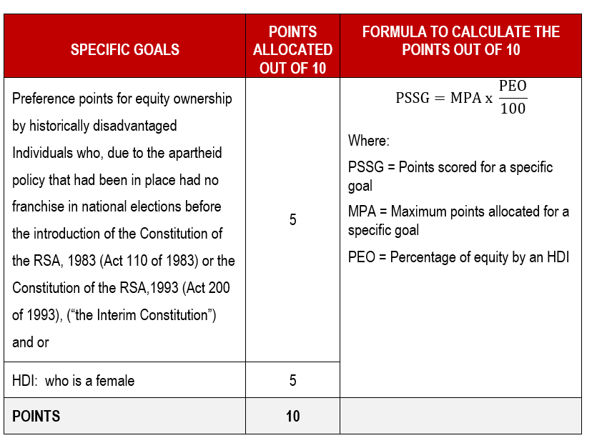
RT66-2025: SUPPLY AND DELIVERY OF TACTICAL AND CRIME SCENE EQUIPMENT TO THE STATE FOR THE PERIOD OF THIRTY-SIX (36) MONTHS

Slide 17
RT66-2025: SUPPLY AND DELIVERY OF TACTICAL AND CRIME SCENE EQUIPMENT TO THE STATE FOR THE PERIOD OF THIRTY-SIX (36) MONTHS
Group Series
Bidders must take note of group series items
Requirements for group series items
Bidder must submit an offer for all items in a series.
All items must pass sample evaluation.
All items must be compatible/same brand in a series.

Slide 18
RT66-2025: SUPPLY AND DELIVERY OF TACTICAL AND CRIME SCENE EQUIPMENT TO THE STATE FOR THE PERIOD OF THIRTY-SIX (36) MONTHS
CONTRACT PRICE ADJUSTMENT
Bidders are required to take note of paragraph13
Price adjustment periods – Yearly
Dates : Table 9 on page 32
Price adjustment will only be effective once it is approved.
Price adjustment is not automatic therefore bidders must apply for price adjustment and attache the necessary documents as per Table 8 on page 31

Slide 19
RT66-2025: SUPPLY AND DELIVERY OF TACTICAL AND CRIME SCENE EQUIPMENT TO THE STATE FOR THE PERIOD OF THIRTY-SIX (36) MONTHS
8. TERMS AND CONDITIONS
Counter Conditions
Bidders’ attention is drawn to the fact that amendments to any of the bid conditions or setting of counter conditions by bidders may result in the invalidation of such bids.
The National Treasury reserves the right to change or supplement any information or to issue any addendum to this bid before the closing date and time. The National Treasury and its officers, employees and advisors will not be liable in connection with either the exercise of, or failure to exercise this right.
If the National Treasury exercises its right to change or supplement information in terms of the above clause, it may seek amended bid documents from all bidders.
Fronting
The National Treasury supports the spirit of broad based black economic empowerment and recognizes that real empowerment can only be achieved through individuals and businesses conducting themselves in accordance with the Constitution and in an honest, fair, equitable, transparent, and legally compliant manner. Against this background the National Treasury does not support any form of fronting.

Slide 20
RT66-2025: SUPPLY AND DELIVERY OF TACTICAL AND CRIME SCENE EQUIPMENT TO THE STATE FOR THE PERIOD OF THIRTY-SIX (36) MONTHS
Right Of Award
The State reserves its following rights -:
To award the bid in part or in full,
Not to make any award in this bid or accept any bids submitted,
Request further technical information from any bidder after the closing date,
Verify information and documentation of the bidder(s),
Not to accept any of the bids submitted,
To withdraw or amend any of the bid conditions by notice in writing to all bidders prior to closing of the bid and post award, and
If an incorrect award has been made to remedy the matter in any lawful manner it may deem fit.

Slide 21
RT66-2025: SUPPLY AND DELIVERY OF TACTICAL AND CRIME SCENE EQUIPMENT TO THE STATE FOR THE PERIOD OF THIRTY-SIX (36) MONTHS
9. SUBMISSION OF BIDS
ONLINE SUBMISSION
Bidders must submit their bids online through the eTender Publication portal.
Manual or hardcopy bids are not acceptable.
Video that guides bidders on uploading documents on E tender: https://youtu.be/B7pNseNJYHM
Bid Enquiries: - All enquiries should be in writing to demand.acquisition3@treasury.gov.za.
The closing date for receipt of all enquiries is 20 March 2025. All enquiries beyond the closing date will not be considered.

Slide 22
RT66-2025:SUPPLY AND DELIVERY OF TACTICAL AND CRIME SCENE EQUIPMENT TO THE STATE FOR THE PERIOD OF THIRTY-SIX (36) MONTHS

